Slide 1
Database system
Saba Ghani
FAST-NU
Chiniot Faisalabad Campus

Slide 2
DDL

Slide 3
Index
An index is a schema object. It is used by the server to speed up the retrieval of rows by using a pointer.
An index helps to speed up select queries and where clauses.
Indexes can be created or dropped with no effect on the data.
When Should Indexes be Created?
A column contains a wide range of values.
A column does not contain a large number of null values.
One or more columns are frequently used together in a where clause or a join condition.

Slide 4
Create index
The CREATE INDEX statement is used to create indexes in tables.
An index can be created in a table to find data more quickly and efficiently.
The users cannot see the indexes, they are just used to speed up searches/queries.
CREATE INDEX index_name ON table_name (column_name)

Slide 5
Create index
The SQL statement below creates an index named "PIndex" on the "LastName" column in the "Persons" table:
CREATE INDEX PIndex ON Persons (LastName)
CREATE INDEX PIndex ON Persons (LastName, FirstName)

Slide 6
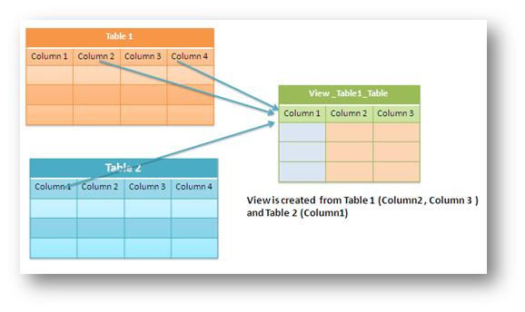
Views (DDL Command)
A view is a virtual table based on the result-set of an SQL statement.
A view contains rows and columns, just like a real table. The fields in a view are fields from one or more real tables in the database.
A View is auto updated table ( when actual tables updates views are also update)

Slide 7

Views (DDL Command)
View is Virtual relation that does not necessarily actually exist in the database but is produced upon request, at time of request.

Slide 8
Views Syntax
Create View View_Name AS
(
select statement From Clause Where condition Group by Having Condition
Order by
);

Slide 9
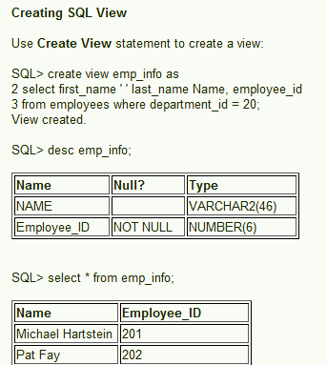
Views

Slide 10
Views (DDL Command)
Following is an example to update the age of Ramesh:
1. UPDATE CUSTOMERS_VIEW
SET AGE = 35
WHERE name='Ramesh';
2. DELETE FROM CUSTOMERS_VIEW
WHERE age = 22;
3. You need a way to drop the view if it is no longer needed.
DROP VIEW CUSTOMERS_VIEW;

